Slide 1
Law and jurisdiction
Facilitating a better future
April 2026
Notes:
How to use this slide layout:
Type your text into the placeholders on the slide

Slide 2
Agenda
Introduction - Arabella Ramage (LMA)
Law and Jurisdiction Clauses – Harry Wright (7 King’s Bench Walk)
Forms of Dispute Resolution – Rani Noakes (4 Pump Court)
Q&A – moderated by Katy Wilson (Ascot and Chair of LMA Legal Committee)
Notes:
How to use this slide layout:
Type your text into the placeholders on the slide

Slide 3
Law and jurisdiction clauses
Harry Wright, 7 King’s Bench Walk

Slide 4
What is a law and jurisdiction clause?

Slide 5
Distinguish the following:
Territorial scope of cover
Physical location of risk
Service of suit clause
Arbitration clause

Slide 6

Do I really need one?
Yes!
But just one
Not necessarily English law…
(but it may help)

Slide 7

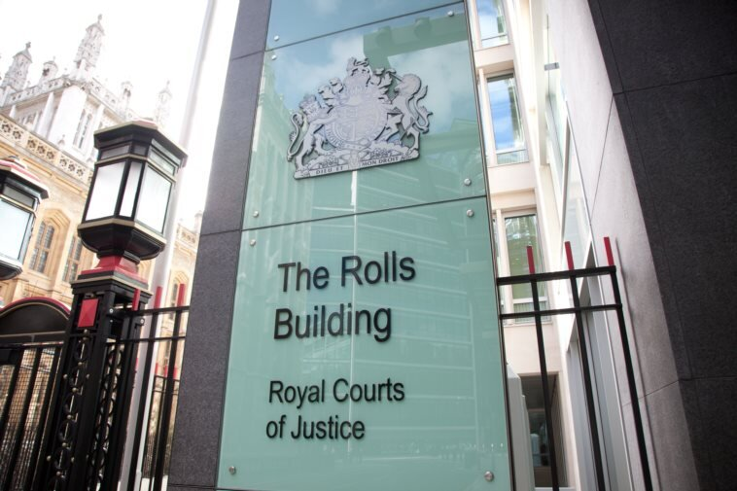
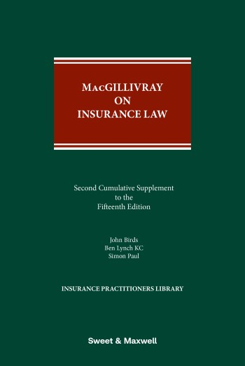
Why do they matter?

Slide 8

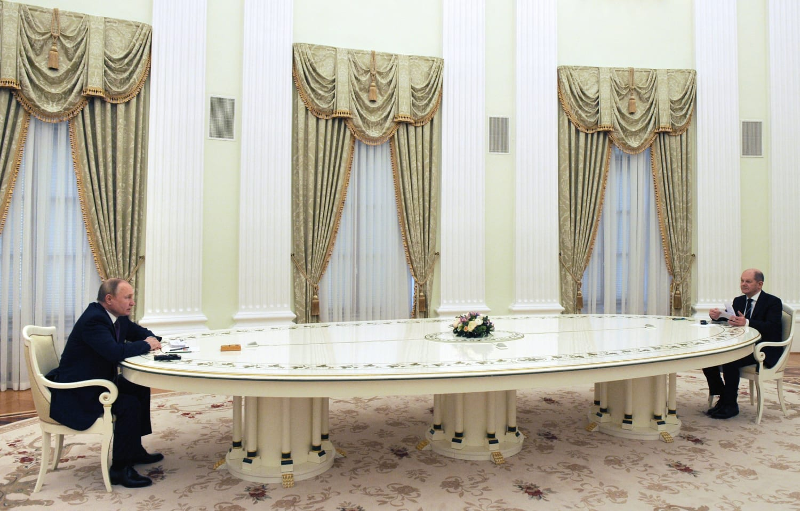
Why do they matter?
Law and jurisdiction
This contract shall be governed by Russian Law and is subject to the exclusive jurisdiction of the Russian Courts

Slide 9
Harry Wright
7 King’s Bench Walk
Temple
London EC4Y 7DS
+44 (0)20 7910 8300
seniorclerks@7kbw.co.uk
These slides are provided only for training and information purposes.
These slides may be circulated only within the firm to which the original presentation was made. Please do not share externally.
No responsibility or liability is accepted for any errors or omissions.
These slides are no substitute for taking legal advice (from members of 7KBW) and are not to be relied upon.
©7KBW | Barristers regulated by the Bar Standards Board

Slide 10

Forms of dispute resolution

Slide 11

What is the difference between resolving a dispute by litigation (in court), arbitration, or by mediation?

Slide 12
Key differences: advantages and disadvantages
Feature | Court Litigation | Arbitration | Mediation
Control | Low (Judge decides the procedure and the outcome) | Moderate to Low (Arbitrator(s) decide the outcome but there is capacity for the parties to choose their arbitrator(s) and the procedure) | High (Parties decide whether to settle their dispute and, if so, on what terms)
Formality | High (much of the procedure prescribed by court rules) | Flexible (parties can choose suitable arbitral rules or their own ad hoc rules*) | Informal (format entirely driven by the parties, facilitated by mediator)
Finality | Legally binding judgment (generally appeals are possible) | Final and binding award (appeals may be possible*) | Not binding until agreement has been reached and reduced to an enforceable contract
Privacy | Public record | Private hearing and presumption of confidentiality | Private process and confidential
Cost / Time | High / Long* | Moderate to High * | Low to Moderate

Slide 13
Some key points about arbitration

Slide 14

Why is an arbitration award “as good” as a court judgment?
Almost all arbitration awards will be “New York Convention Awards”: see the parties to the 1958 Convention on the Recognition and Enforcement of of Foreign Arbitral Awards at: https://www.newyorkconvention.org/contracting-states
To enforce an award, it must go through a process of recognition and enforcement. This typically happens by converting the award into a judgment of a local court (a process known as “exequatur”).
Local courts in different jurisdictions will have their own local procedure.
In England and Wales, following an application under the CPR Part 62, judgment will be entered in the same terms as the Award (s66 Arbitration Act 1996). Thereafter it can be enforced in the same way as a judgment of the English Court.

Slide 15
The arbitral process
Precisely how the arbitration proceeds will depend on what has been specifically agreed via the arbitration agreement.
Institutional vs ad hoc arbitration.
Institutional arbitration:
The parties adopt a set of rules formulated by one of the arbitral institutions which administers the process, e.g. agreement to “LCIA arbitration seated in London”.
Ad hoc arbitration:
The parties manage the arbitration process themselves without the administration or procedural framework of an arbitral institution, e.g. agreement to “arbitration seated in London”.

Slide 16
For further reading, the LMA has undertaken an extremely useful summary comparison of seven sets of institutional rules, which can be found here:
https://lmalloyds.com/specialist-areas/legal/legal-and-compliance-useful-documents/comparison-of-arbitration-rules/
Have in mind things such as:
Arbitrator selection – number of arbitrators
Impartiality
Qualification of the arbitrator
Confidentiality
Consolidation
Costs
Duration
Written reasoned awards
Appeals
Powers of the Tribunal – advance payment of costs, early determination, injunctive relief, punitive damages

Slide 17
Extent of Court oversight
Just because the parties have chosen arbitration, it does not mean that the Court will not be involved in the process at all.
It is often necessary for the parties to have recourse to the Court’s supervisory jurisdiction (exercised by the courts of the “seat of the arbitration” or “lex arbitri”) for the purposes of ensuring the integrity of the process and supporting it.
The Court’s supervisory jurisdiction may extend e.g. to enforcing the arbitration agreement by anti suit injunction, issuing interim relief e.g. freezing injunctions, and determining challenges to the award rendered by the arbitral tribunal.

Slide 18
Degree of Court oversight
It depends on (1) the curial law of the arbitration; and (2) what has been / can be agreed via the arbitration agreement.
Some institutional rules attempt to oust rights of appeal, if it is possible consistent with the law governing the arbitration agreement e.g. LCIA Rules
Art 29.2 To the extent permitted by any applicable law, the parties shall be taken to have waived any right of appeal or review in respect of any determination and decision of the LCIA Court to any state court or other legal authority. If such appeal or review takes place due to mandatory provisions of any applicable law or otherwise, the LCIA Court may determine whether or not the arbitration should continue, notwithstanding such appeal or review.
Whether rights of appeal have been successfully ousted will be a question for the law governing the arbitration agreement.
Often it is possible for the parties to contract out of the right to appeal for error of law but not when it comes to challenges to the jurisdiction of the tribunal or serious irregularity i.e. matters affecting the arbitral process itself.

Slide 19
Concluding comments

Slide 20
Questions

