Slide 1
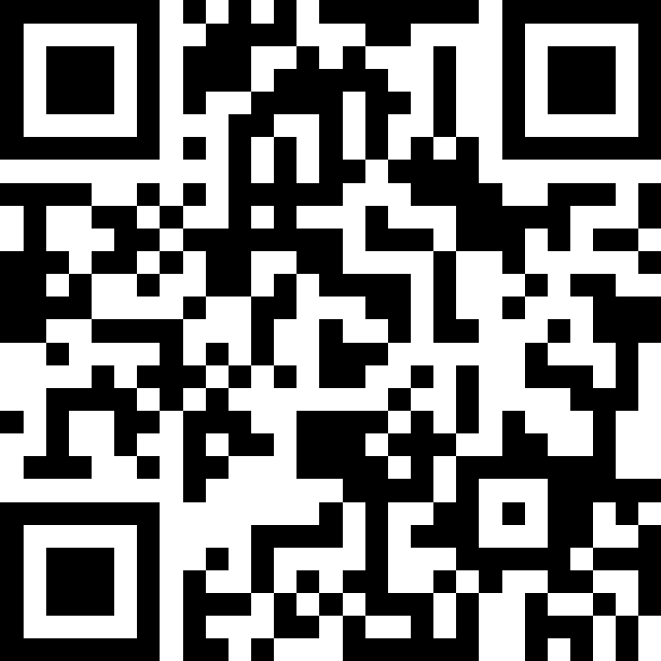
Strait of Hormuz: Sanctions and Financial Crime Implications for Marine Insurance
Facilitating a better future
29 April 2026
Notes:
How to use this slide layout:
Type your text into the placeholders on the slide

Slide 2
Reminder
The content of today’s presentation is for information and guidance only.
The opinions and views expressed by any of the speakers today are their own and do not necessarily represent the views, policies, or positions of the LMA. The views expressed also do not represent legal advice.
Attendees should take their own legal advice on any particular scenario/ fact pattern discussed. The LMA and the speakers do not accept any liability for any actions taken or reliance upon the content of this presentation.
Strait of Hormuz: Sanctions and Financial Crime Implications for Marine Insurance

Slide 3
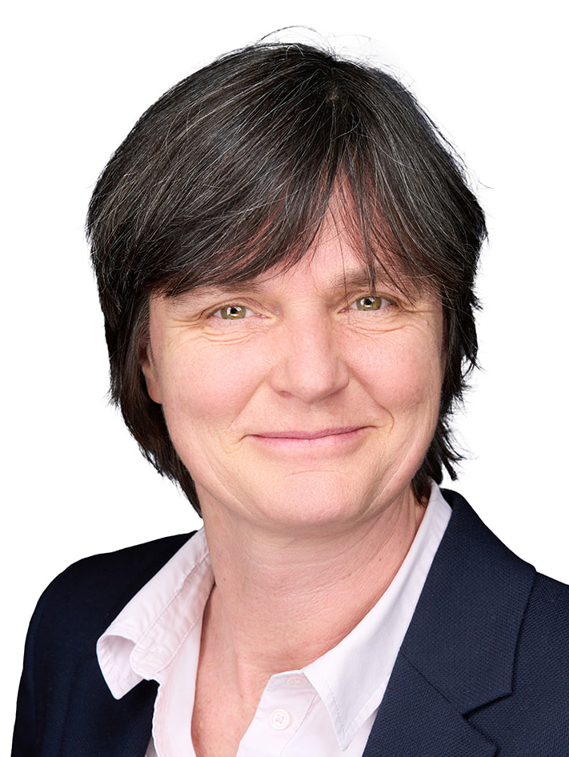

Arabella Ramage
Legal and Regulatory Director
LMA
Neil Roberts
Head of Marine and Aviation
LMA

Slide 4
Event description
This briefing will consider financial crime and sanctions questions arising for insurers with respect to the insurance of commercial shipping transiting the Strait of Hormuz.
It will be led by John Kimbell KC (Quadrant Chambers), with UK Terrorism Act and other financial crime considerations to be highlighted by Richard Neylon (Holman Fenwick Willan LLP).
The speakers will outline their key legal conclusions, in particular in relation to:
  The sanctions and financial crime implications for existing and new marine coverages.
  Payment of transit fees for the Strait.
  Safeguards that insurers should be considering.
  Related reporting and compliance issues.
Strait of Hormuz: Sanctions and Financial Crime Implications for Marine Insurance

Slide 5

John Kimbell KC
John Kimbell KC practises from Quadrant Chambers in London. He specialises in all aspects of shipping, aviation and insurance law. In addition to his work in the High Court, he represents a wide range of clients in commercial arbitration (LMAA, GMAA, ICC, LCIA and DIS). He also acts as a commercial arbitrator in London and Hamburg (LMAA, LCIA, ICC, GMAA), including a recent arbitration relating to Iranian sanctions in the context of Iranian oil exports. From 2018-2024, he sat as a Deputy High Court Judge in the High Court (Chancery, IPEC, LCCC and KBD) and was appointed a Crown Court Recorder in 2019. His shipping work encompasses both collision and other Admiralty Court matters and ‘dry’ bill of lading, charterparty, shipbuilding and marine insurance (in particular war risks) disputes. He regularly appears in the Commercial and Admiralty Court as well as in maritime (LMAA) arbitrations. He is chair of the Admiralty Bar Group, the editor of Admiralty Jurisdiction & Practice (6th edition, 2025) and the co-editor of the Marsden on Collisions at Sea (16th edition, 2025).
Strait of Hormuz: Sanctions and Financial Crime Implications for Marine Insurance

Slide 6

Richard Neylon
Richard Neylon is a Partner at the international law firm Holman Fenwick Willan LLP (HFW), based in London. He handles major incidents and disputes for marine, liability, war and special risks underwriters and their assureds. Richard is a recognised specialist in handling major marine casualties and acts for a range of shipowners, charterers, and insurers in wet and dry shipping disputes. He has particular experience in relation to collisions, fires/explosions, salvage, piracy, capture/seizure, groundings, unsafe port claims and war risks – often involving complex multi-jurisdictional litigation and arbitration. Richard has been at the forefront of advising on marine war risks across global conflict zones for two decades. He is recognised internationally for his work advising shipowners and war risks insurers on incidents arising from Somali and West African piracy, the Houthi attacks in the Red Sea and the Russia/Ukraine conflict. He is currently heavily involved in handling incidents connected to the Iranian conflict, including vessel detentions and attacks in and around the Strait of Hormuz. Richard also heads HFW’s global Complex Environments team, specialising in major incidents and disputes for corporations and their insurers in hostile and complex environments globally. This includes matters arising from major loss, war, terrorism, political risks, kidnappings, hijackings, extortions, detention of people and property, and other challenging events. In 2025, Richard was awarded an Honorary Doctor of Laws (LLD) by his alma mater, Swansea University.
Strait of Hormuz: Sanctions and Financial Crime Implications for Marine Insurance

Slide 7
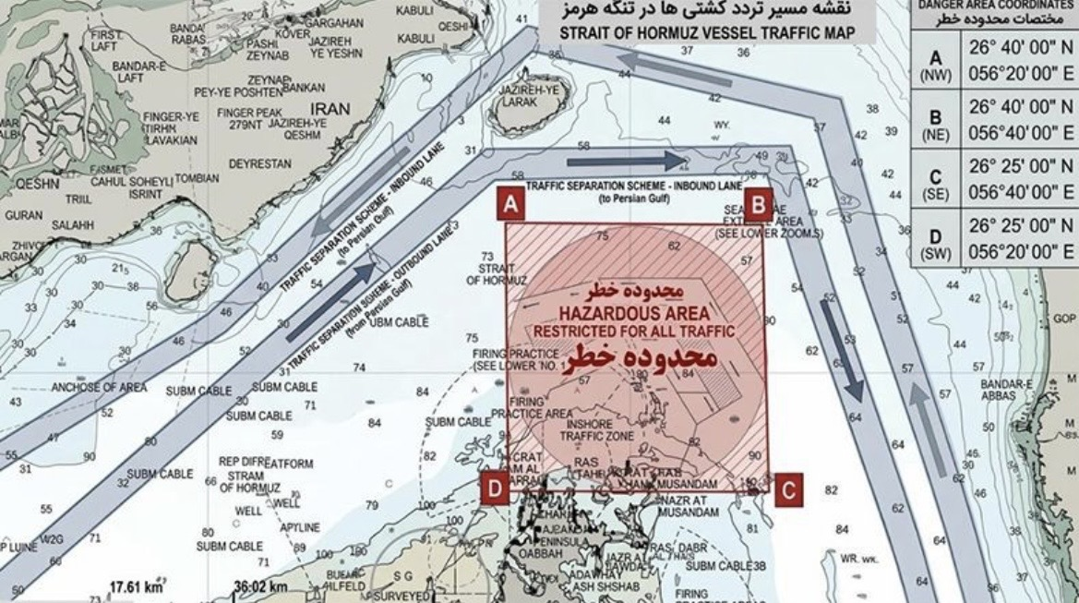
Strait chart
Strait of Hormuz: Sanctions and Financial Crime Implications for Marine Insurance

Slide 8
LMA 3100A – Sanctions Limitation Clause
No (re)insurer shall be deemed to provide cover and no (re)insurer shall be liable to pay any claim or provide any benefit hereunder to the extent that the provision of such cover, payment of such claim or provision of such benefit would expose that (re)insurer to any sanction, prohibition or restriction under United Nations’ resolutions or the trade or economic sanctions, laws or regulations of the European Union, United Kingdom or United States of America.
Strait of Hormuz: Sanctions and Financial Crime Implications for Marine Insurance

Slide 9
LMA 3200 – Sanctions Suspension Clause
It is a condition of this (re)insurance, and the (re)insured agrees, that the provision of any cover, the payment of any claim and the provision of any benefit hereunder shall be suspended, to the extent that the provision of such cover, payment of such claim or provision of such benefit by the (re)insurer would expose that (re)insurer to any sanction, prohibition or restriction under any:
  United Nations’ resolution(s); or
  the trade or economic sanctions, laws or regulations of the European Union, United Kingdom or United States of America.
Such suspension shall continue until such time as the (re)insurer would no longer be exposed to any such sanction, prohibition or restriction.
Strait of Hormuz: Sanctions and Financial Crime Implications for Marine Insurance

Slide 10
John Kimbell KC
Barrister
Quadrant Chambers
Richard Neylon
Partner
HFW

