Slide 1


War, Terrorism and Clarity
Wi-Fi: Antares-Guest​
Password: Connect@Antares
Notes:
How to use this slide layout:
Type your text into the placeholders on the slide

Slide 2
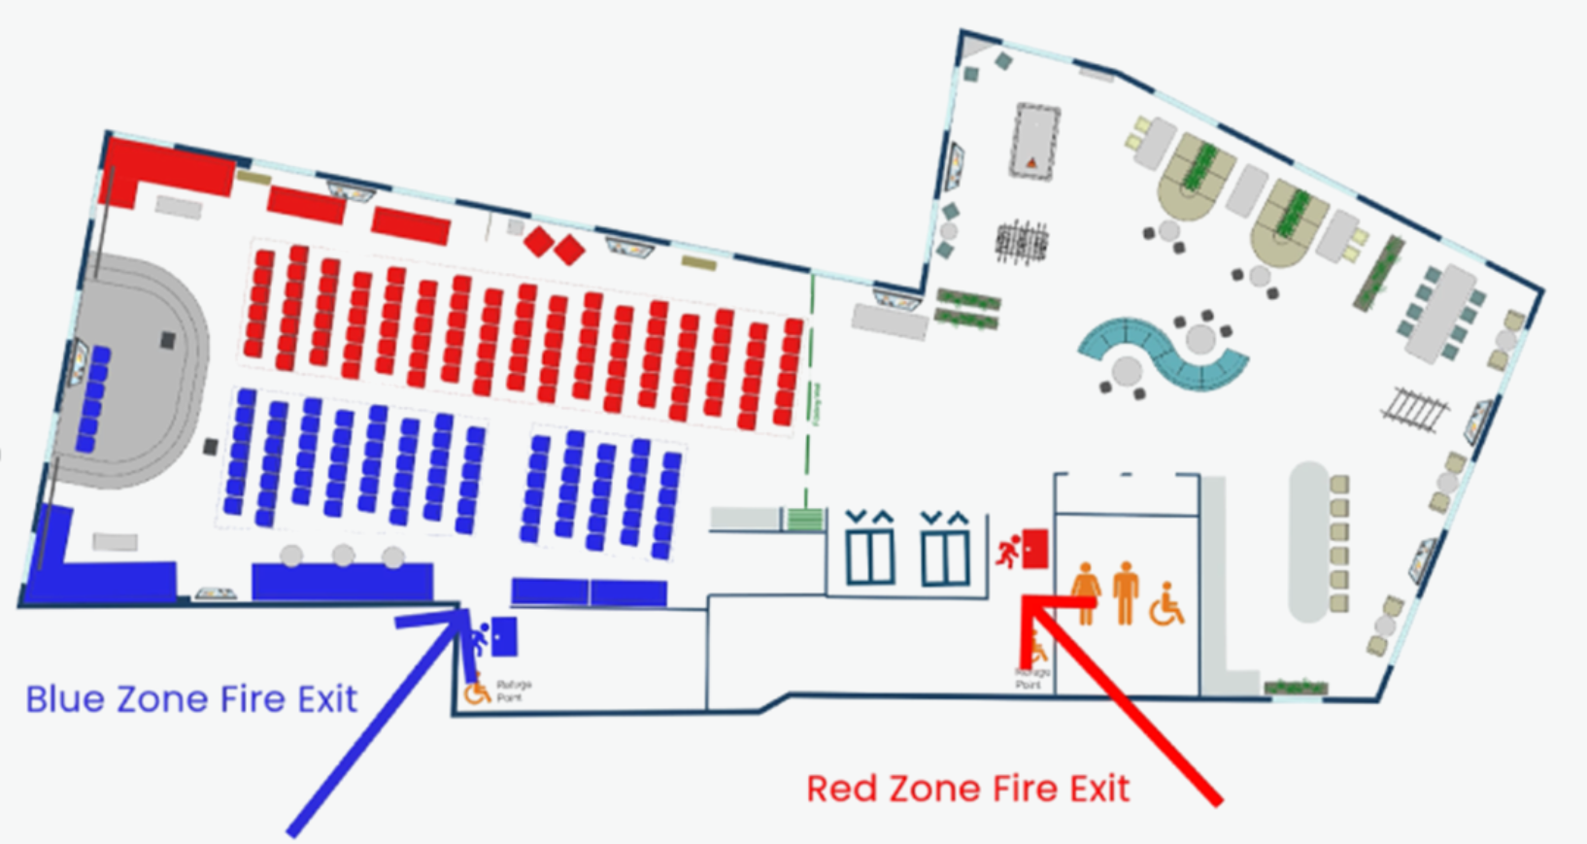

Housekeeping - Fire Evacuation Procedure
Primary assembly point: Pret-a-Manger, 77–80 Gracechurch Street.​

Slide 3


Introductory remarks
Michael van der Straaten
CEO
Antares

Slide 4




Panel discussion
Wesley Selwyn
Class Underwriter
Antares
Nick Lang
Class Underwriter
Antares
Neil Roberts
Head of Marine and Aviation
LMA
Arabella Ramage
Legal and Regulatory Director
LMA

Slide 5
Analysis of LMA clauses
What guides the analysis:
War insurance is intended to cover war; and
Other forms of insurance such as terrorism need to be clearly differentiated;
A policy needs to clearly identify whether it covers cyber war or not;
It is in nobody except the lawyer’s interests for any of these points to have to be decided at length in a Court – bad for the reputation of the market in particular.

Slide 6
Background
What is war?
Evolution
Conflicts
  Leyland Shipping
  Kawasaki 1939
  Brillante Virtuoso
Listed Areas

Slide 7
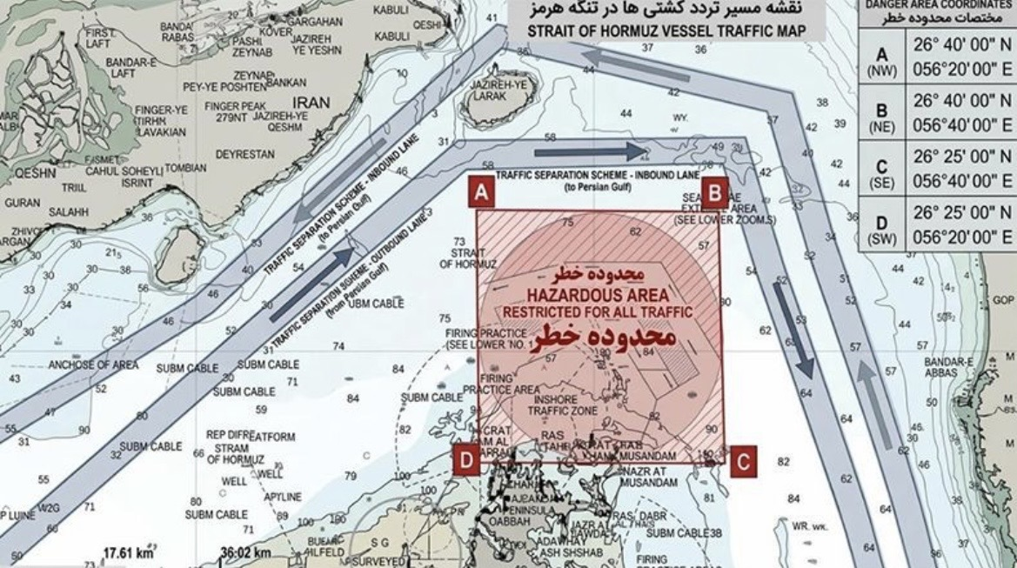
Gulf conflict

Slide 8
Five powers clause (example)
This insurance excludes
  4.1 loss damage liability or expense arising from
    4.1.1 any detonation of any weapon of war employing atomic or nuclear fission and/or fusion or other like reaction or radioactive force or matter, hereinafter called a nuclear weapon of war
    4.1.2 the outbreak of war (whether there be a declaration of war or not) between any of the following countries:
      United Kingdom, United States of America, France,
      the Union of Soviet Socialist Republics,
      the People's Republic of China.

Slide 9
Automatic Termination Clause
Whether or not such notice of cancellation has been given cover hereunder in respect of the risks of war, etc. shall TERMINATE AUTOMATICALLY
2.1 upon the outbreak of war (whether there be a declaration of war or not) between any of the following:
United Kingdom, United States of America, France, the Russian Federation, the People’s Republic of China;
2.2 in respect of any vessel, in connection with which cover is granted hereunder, in the event of such vessel being requisitioned either for title or use.

Slide 10
NATO Article 5
The Parties agree that an armed attack against one or more of them in Europe or North America shall be considered an attack against them all and consequently they agree that, if such an armed attack occurs, each of them, in exercise of the right of individual or collective self-defence recognised by Article 51 of the Charter of the United Nations, will assist the Party or Parties so attacked by taking forthwith, individually and in concert with the other Parties, such action as it deems necessary, including the use of armed force, to restore and maintain the security of the North Atlantic area.
Any such armed attack and all measures taken as a result thereof shall immediately be reported to the Security Council. Such measures shall be terminated when the Security Council has taken the measures necessary to restore and maintain international peace and security.

Slide 11
Notice of Cancellation
Where this policy insures liability, loss, damage, cost or expense caused by, arising out of or in any way connected with one or more of the following risks:
1.1 war, civil war, revolution, rebellion, insurrection, or civil strife arising therefrom, or any hostile act by or against a belligerent power;
1.2 capture, seizure, arrest, restraint, or detainment, and the consequences thereof or any attempt thereat;
1.3 derelict mines, torpedoes, bombs, or other derelict weapons of war;
1.4 strikes, locked-out workmen, or persons taking part in labour disturbances, riots or civil commotions;
1.5 terrorism, or any person acting maliciously or from a political motive;
1.6 confiscation, nationalisation, expropriation, deprivation or requisition,
this policy may be cancelled in respect of these risks only by the Underwriters giving 72 hours’ notice of cancellation (hereinafter “Notice”) in the way described in clause 3 below, with Notice being effective from midnight Greenwich Mean Time on the day Notice is given by the Underwriters.
The Underwriters may subsequently agree to reinstate cover, if required, at terms to be agreed by the Underwriters each for their own share. Any reinstatement of cover shall occur at a time to be agreed by the Underwriters.

Slide 12
A – Outbreak of war triggers for ATC and Five Powers clauses
A1 A formal declaration war by any of the Five Powers against one or more of the other Five Powers, or;
A2 An armed response, triggered by an armed attack within the meaning of Article 51 of the Charter of the United Nations, leading to armed conflict between any of the Five Powers, or;
A3 Deployed forces of one Five Powers country directly engaging in armed conflict with those of another Five Power country in an international operation, whether or not in a third country, or;
A4 Hostile action by any Five Power country (whether physical or non-physical) against another Five Power country resulting in damage to critical infrastructure at a level sufficient to impact the functioning of another Five Power country;

Slide 13
B – Actions not triggering ATC or Five Powers clauses
B1 Deployment of advisers by a Five Power country to a third country
B2 Supply of armaments by a Five Power country to a third country
B3 Aerial incursion by a Five Power country across another Five Power country’s border without release of weapons against the country affected
B4 Incursion by a Five Power country into another Five Power country’s Territorial waters without release of weapons against the country affected
B5 Action taken by armed forces of a Five Power country to neutralise an uncrewed aircraft or vessel of another Five Power country in the circumstances described in B3 and B4
B6 Damage to undersea or offshore infrastructure of a Five Power country unless resulting in casualties equivalent to those sustained in an armed attack
B7 Cyber-attack against a Five Power country unless the circumstances in A4 occur
B8 Terrorist action within the territory of a Five Power unless one of the Five Powers alleges that the terrorist action was supported by one of the other Five Powers;
B9 Any action where all of the Five Power countries allegedly involved in a war against another Five Power country give a statement that they are not at war.

Slide 14
Cyber war exclusions: LMA5567A
1 Notwithstanding any provision to the contrary in this insurance, this insurance does not cover that part of any loss, damage, liability, cost, or expense, of any kind:
  1.1 directly or indirectly arising from a war, and/or
  1.2 arising from a cyber operation that is carried out as part of a war, or the immediate preparation for a war, and/or
  1.3 arising from a cyber operation that causes a state to become an impacted state.
Paragraph 1.3 shall not apply to the direct or indirect effect of a cyber operation on a computer system used by the insured or its third party service providers that is not physically located in an impacted state but is affected by a cyber operation.
Attribution of a cyber operation to a state
2 Notwithstanding the insurer’s burden of proof, which shall remain unchanged by this clause, in determining attribution of a cyber operation to a state, the insured and insurer will consider such objectively reasonable evidence that is available to them….
Definitions
5 Essential service means a service that is essential for the maintenance of vital functions of a state including, but not limited to, financial institutions and associated financial market infrastructure, health services or utility services.
6 Impacted state means any state where a cyber operation has had a major detrimental impact on:
  6.2 the functioning of that state due to disruption to the availability, integrity or delivery of an essential service in that state, and/or
  6.2 the security or defence of that state.

Slide 15
ANTARES SYNDICATE 1274 | CYBER, TECHNOLOGY & MEDIA
Cyber War &
The Attribution Problem
From NMA 464 to affirmative cover: eighty years of war exclusion, and the model the cyber market is rebuilding
Antares Managing Agency Limited | May 2026

Slide 16

ACT 1 · THE SETTLED POSITION
NMA 464 the war exclusion that lasted eighty years
Excluding war has been a feature of insurance for centuries, and remains a fundamental compliance requirement for policies written at Lloyd's.
Until the late twentieth century, the exercise was comparatively unambiguous. NMA 464, drafted before the Second World War, did the job across multiple classes of business and remained largely unaltered for decades.
NMA 464 · c.1938
"…this Certificate does not cover Loss or Damage directly or indirectly occasioned by, happening through or in consequence of war, invasion, acts of foreign enemies, hostilities (whether war be declared or not), civil war, rebellion, revolution, insurrection, military or usurped power…"
It worked because war, in 1938, looked like war.
It was developed by Lloyd's of London and the London Market in response to the Spanish Civil War (1936–1939) and the Italo-Ethiopian War
Antares Managing Agency Limited | Syndicate 1274 | Cyber, Technology & Media
3 / 15

Slide 17

ACT 2 · WHEN CYBER BROKE THE MODEL
Three events forced the rewrite and a court ruling settled the question
2010
2014
2017
2022
Stuxnet
Sony Pictures
NotPetya
Merck v ACE
A cyber operation causes physical damage to centrifuges in Iran's uranium enrichment hardware. Doesn’t look like terrorism or warfare.
The Interview release triggers a destructive intrusion. It’s been publicly attributed to North Korea, a foundational case for state-actor cyber.
An indiscriminate wiper, exploiting a Microsoft vulnerability, spreads beyond its targets and causes billions in damage worldwide.
A New Jersey court rules a generic property policy war exclusion does not capture state-sponsored cyber. Insurers must now exclude it explicitly.
After Merck, generic war language was no longer fit for purpose. The market needed cyber-specific exclusions, and a way to handle attribution.
Antares Managing Agency Limited | Syndicate 1274 | Cyber, Technology & Media

Slide 18

THE MARKET'S RESPONSE
The LMA model clauses: four wordings, one shared architecture
Following Merck, the LMA produced four cyber-specific war exclusions, each defining 'War', 'Cyber Operation', 'Essential Service' and a structured approach to attribution.
LMA5564
LMA5565
LMA5566
LMA5567
Exclusion No. 1
Exclusion No. 2
Exclusion No. 3
Exclusion No. 4
Excludes war and any cyber operation. The broadest of the four; no carve-out for non-war state operations.
Excludes war-related cyber and major impairment to a state's essential services or security; sub-limits available.
As No. 2, but limits the bystander reach where the impacted state is geographically distant.
As No. 3, plus a carve-back for bystanding cyber assets, the narrowest exclusion of the family.
Lloyd's framework: Market Bulletin Y5381 (August 2022) made a state-backed cyber-attack exclusion mandatory in CY/CZ standalone policies from 31 March 2023. Y5433 (May 2024) updated the classification (Type 1–7) and critically opened the door to affirmative cover where exclusion alone leaves a gap.
Antares Managing Agency Limited | Syndicate 1274 | Cyber, Technology & Media
7 / 14

Slide 19


Slide 20



A BRIEF NOTE ON GEOPOLITICAL DISCRETION
Introducing two jurisdictions, drawn entirely from fiction
To discuss how the LMA model clauses respond to a real cyber operation would require us to name a real aggressor and a real target. Given the audience, I have decided this is an excellent opportunity to invent two countries.
The Democratic Republic of Wes
Nickland
HEAD OF STATE
AGGRESSOR
HEAD OF STATE
TARGET
Supreme Emperor Wesley Selwyn
First Representative Nicholas Lang
Government type
Hereditary Imperium (constitution forthcoming)
Government type
Direct technocracy (one underwriter, one vote)
Population
1 (Imperial Census, 2026)
Population
1
National motto
"In imperatore confidimus"
National motto
"Nil satis nisi optimum."
Principal export
Underwriting opinions
Principal export
Underwriting opinions
Cyber capability
State-grade. Probably.
Critical infra.
Power, water, gas — i.e. "essential services"
In the slide that follows: The DRW conducts a cyber operation against essential services in Nickland, with bystander spread. Any resemblance to real states or operations is unintended, and considerably less politically sensitive.
Antares Managing Agency Limited | Syndicate 1274 | Cyber, Technology & Media

Slide 21
WORKED EXAMPLE
Same incident, four wordings: how the LMA clauses respond to NotPetya like events
ANGRY PENGUIN · May 2026
A Democratic Republic of Wes attributed wiper, triggered against Nickland, state and commercial systems via a compromised HR-software supply chain. Malware spread uncontrolled across the global internet. Estimated aggregate loss: USD ~10bn — Maersk, Merck, Mondelez, FedEx, NHS and others.
LMA5564A
LMA5565A
LMA5566A
LMA5567A
Exclusion No. 1
Exclusion No. 2
Exclusion No. 3
Exclusion No. 4
IN IMPACTED STATE
IN IMPACTED STATE
IN IMPACTED STATE
IN IMPACTED STATE
EXCLUDED
EXCLUDED
EXCLUDED
EXCLUDED
OUTSIDE · BYSTANDER
OUTSIDE · BYSTANDER
OUTSIDE · BYSTANDER
OUTSIDE · BYSTANDER
EXCLUDED
EXCLUDED
EXCLUDED
COVERED
Carve-back for computer systems used by the insured or its third-party service providers that is not physically located in an impacted state. Loss to systems located outside the impacted state is preserved from the impairment exclusion.
Categorical exclusion of any cyber operation. The trigger is the operation itself, regardless of target or geography.
Major-impairment trigger (Nickland essential services) captures both insureds. Sub-limit reserved for ordinary, non-state cyber events only.
Same exclusion scope as No. 2; no sub-limit fallback. Computer systems located within the impacted state fall within the same impairment trigger.
Inflection point: only the bystanding cyber asset carve-back in LMA5567 returns cover for systems outside the impacted state. Across the other three, the malware is excluded everywhere it lands.
Antares Managing Agency Limited | Syndicate 1274 | Cyber, Technology & Media

Slide 22
ACT 4 · THE WORKING HALLMARK
Complexity as proxy — and the EternalBlue lesson
THE WORKING RULE
ETERNALBLUE · 2017
Where affirmative attribution is unavailable, the next best indicator is the complexity of the toolkit, the resource, the exploit chain, as a proxy for state sponsorship.
State-grade tooling does not stay in state hands.
→
An NSA-developed exploit, leaked, weaponised within weeks. Complexity, useful as it is, can lag the truth by years.
Provenance is not authorship. Complexity is necessary, not sufficient.
Antares Managing Agency Limited | Syndicate 1274 | Cyber, Technology & Media

Slide 23
ACT 4 · CONTINUED
AI compresses the window: and the working test starts to bend
What changed
The patch window. The gap between disclosure and weaponization, has effectively collapsed. Capability that was once gated by expertise is increasingly gated by access to compute.
Why it matters for attribution
If individuals can do in hours what previously took state teams in years, complexity becomes a weaker proxy for sponsorship. The market's working test is still useful, but the threshold is moving.
2017
2026
2yrs
7hrs
from disclosure to working exploit
from disclosure to working exploit
Source: Coalition Activate 2026; Antares Mythos commentary, April 2026.
Antares Managing Agency Limited | Syndicate 1274 | Cyber, Technology & Media
9 / 14

Slide 24

ACT 4 · THE HARDER QUESTION
Mythos and the limits of complexity-as-proxy
ANTHROPIC MYTHOS
AI-assisted vulnerability research at machine speed
If a tool that approaches state-grade research capability is built and run by a non-state actor, what does the complexity of an attack still tell you about its origin?
Identifies kernel-level vulnerabilities in long-standing, often unsupported codebases.
Chains low-severity bugs into composite exploit paths a human analyst would not pursue.
Operates continuously, without fatigue or prioritisation constraints.
Developer is a private US AI company, not a state actor.
The honest answer is: less than it used to. The market's working test for state sponsorship, sophistication, needs to be supplemented by a contractual mechanism that does not depend on the test holding firm.
Antares Managing Agency Limited | Syndicate 1274 | Cyber, Technology & Media
10 / 14

Slide 25



ACT 5 · THE AFFIRMATIVE RESPONSE
Antares, with Lloyd’s: affirmative cyber war for US essential services
Y5433 opened the door for syndicates to provide state-backed cyber cover through a clear, distinct affirmative grant. Antares is now writing this product on the CAP Lineslip (Acrisure), in conjunction with Canopius and with Lloyd's approval.
Targeted at essential services
Removes the attribution dispute
Controlled, Lloyd's-overseen exposure
US utilities: power, water, gas, the precise sectors carved into the LMA's 'Essential Service' definition and the systems most-targeted by sophisticated actors.
Where the underlying exclusion would otherwise turn on a contested attribution finding, the affirmative grant gives clarity of cover at the moment it matters most.
Set aggregate across the Lineslip and per-client. Aggregate managed at programme level, not per policy.
Lloyd's classification: Type 6 (approved).
Antares Managing Agency Limited | Syndicate 1274 | Cyber, Technology & Media
11 / 14

Slide 26
WHY THIS RISK, AND WHY THESE INSUREDS
The case for affirmative cover, rather than reliance on exclusion
WHY US UTILITIES, IN PARTICULAR
WHY AFFIRMATIVE COVER
Definitionally 'Essential Services' under both the policy wording and Lloyd's framework.
Mandatory service obligations under FERC/NERC CIP standards exposure cannot be declined operationally.
Among the better-protected estates, supported by federal threat-intelligence sharing through DHS/CISA.
An attack of the scale required to cause meaningful damage will, by definition, almost certainly meet the complexity threshold for state sponsorship.
Aligns with Lloyd's stated preference for affirmative over silent cover.
Removes the complication of attribution, the market acknowledges this is harder for non-kinetic acts than for kinetic ones.
Lets exposure be properly priced, properly aggregated, and properly capped at programme level.
Limits the systemic concern: a finite, modelled aggregate is preferable to silent exposure that materialises only in the largest events.
Essential infrastructure is better protected when its insurance does not depend on a contested attribution finding to respond.
Antares Managing Agency Limited | Syndicate 1274 | Cyber, Technology & Media
12 / 14

Slide 27
IN SUMMARY
The arc, in five lines
1
War was excluded.
For most of the twentieth century, NMA 464 did the job. War looked like war.
2
Cyber broke the model.
Stuxnet, Sony, NotPetya and Merck v ACE proved that generic war language could not capture state-led cyber operations.
3
Attribution became the central problem.
Code routes through many hands; states rarely claim. The LMA's 5564–5567 family put attribution architecture on the page.
4
The market settled on complexity as proxy and now AI is bending it.
Exploit windows have collapsed from years to hours. State-grade tooling (EternalBlue) leaks. Mythos shows non-state actors approaching state-grade research capability.
5
Affirmative cover is the cleaner path forward.
For US essential services in particular, an affirmative grant with controlled aggregate gives clarity that an attribution-dependent exclusion does not.
Antares Managing Agency Limited | Syndicate 1274 | Cyber, Technology & Media
13 / 14

Slide 28
ANTARES SYNDICATE 1274
The cyber market has spent a decade learning the lesson that attribution is harder in code than it is in kinetics.
Affirmative cover, properly capped and properly governed, is the form of risk transfer that follows from that lesson, and the Antares is supporting this development alongside Lloyd's.
www.antaresglobal.com

Slide 29

London Market –
Political Violence
Coverages offered by the Hiscox 1-5 PV wording:
an act of terrorism and/or sabotage;
malicious damage;
riots, strikes, civil commotion;
invasion, acts of foreign enemies, hostilities (whether war be declared or not) civil war, rebellion, revolution, coup d’etat, insurrection or mutiny;
war

Slide 30
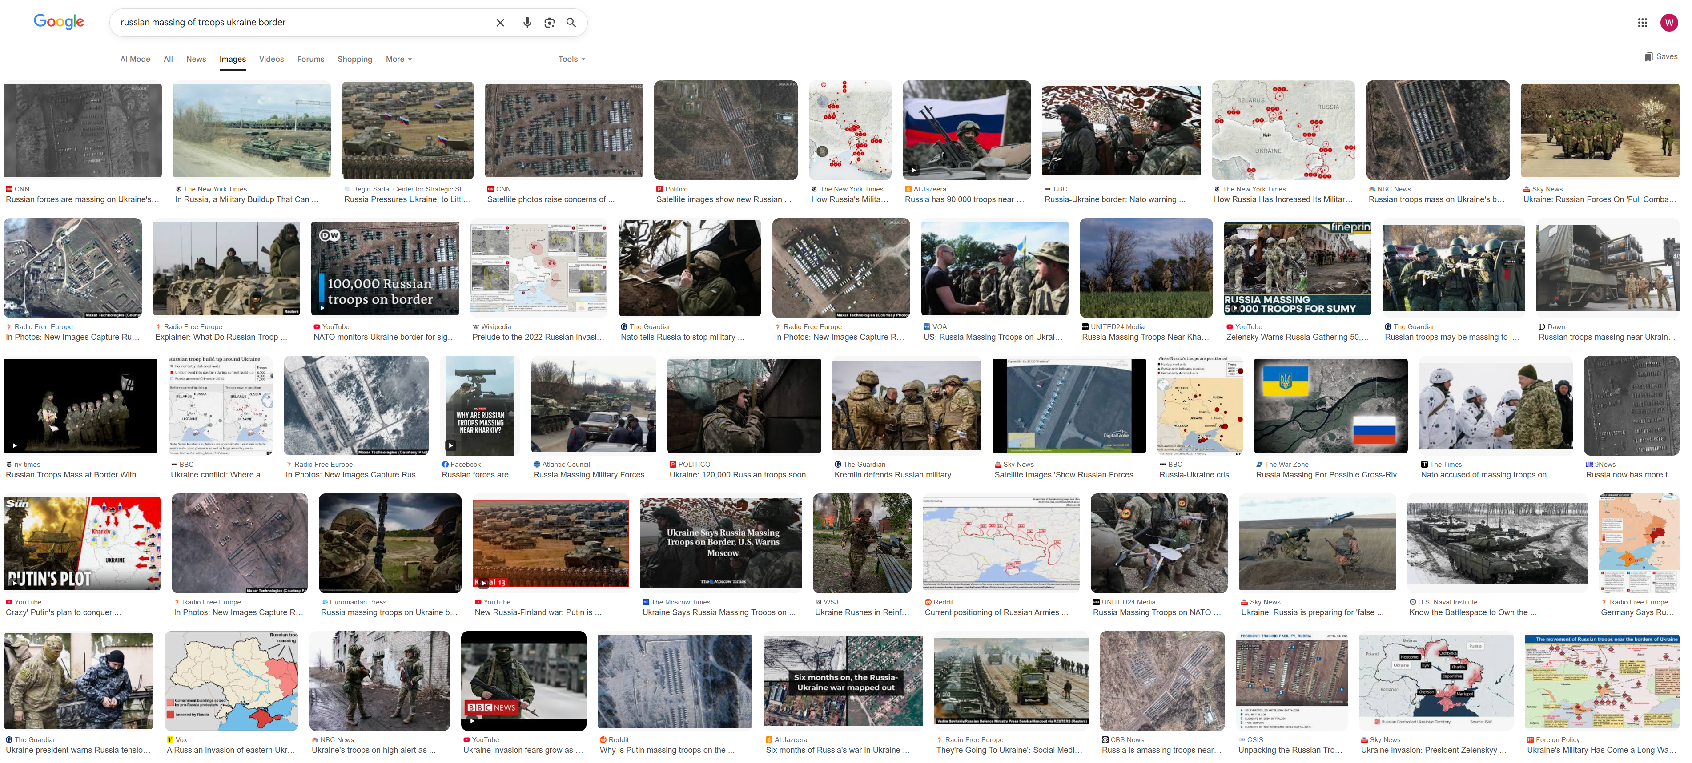
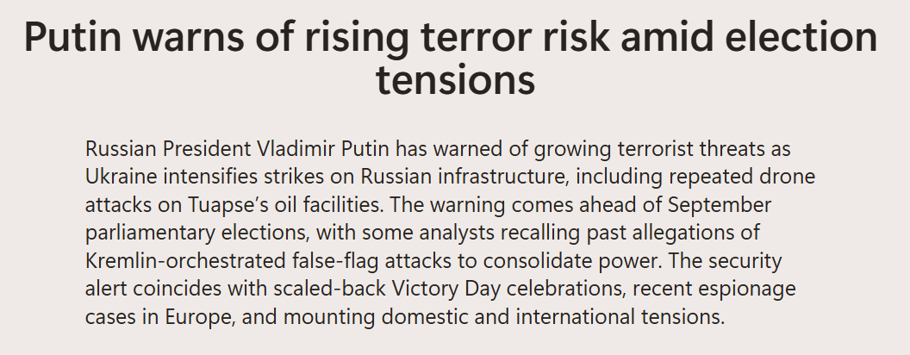
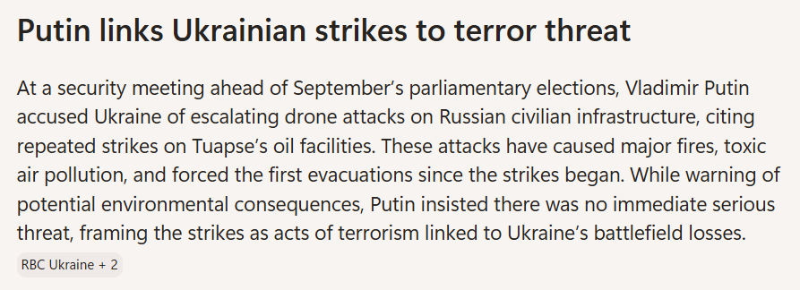
Wednesday 13th May 2026

Slide 31
"War" shall mean a contest by force between two or more sovereign nations, carried on for any purpose, armed conflict of sovereign powers and/or declared or undeclared and open hostilities between sovereign nations.

Slide 32
Q&A
Wi-Fi: Antares-Guest
Password: Connect@Antares

Slide 33
War, Terrorism and Clarity
Notes:
How to use this slide layout:
Type your text into the placeholders on the slide

